Slide 1
Sustainable Enterprise Software
The what, the why, and the how to design and implement
Darryl Cauldwell
Notes:
My name is Darryl Cauldwell and for the last thirty years I have focussed on creating hosting platforms for the development and delivery of enterprise software. Software engineering, the software development lifecycle and hosting platforms are designed and built against constraints.
Sustainability has traditionally not been a constraint used in the design of enterprise software…. It should be. In this talk I’ll aim to highlight some sustainability constraints and provide actionable advise for approaching these.

Slide 2
Today’s enterprise IT systems requires a lot of data centre workload.
Demand for workload is increasing.
Governments and enterprises have made commitments to transform to meet goals of the ‘2030 Agenda for Sustainable Development’.
Renewables are cleaner but less predictable energy supplies.
Notes:
Today’s enterprise IT systems requires a lot of data centre workload. As enterprises continue with digital transformation programs the demand for data centre workload is increasing.
At the same as increasing demand both governments and enterprises have made commitments to transform to meet goals of the ‘2030 Agenda for Sustainable Development’.
As governments modernise their energy grid with increased use of renewable and reduced use of fossil fuels consistent supply forecasting becomes more complex and leads to less reliable energy supply.

Slide 3

2030 Agenda - Sustainable Development Goals
Notes:
The 2030 Agenda for Sustainable Development is a resolution adopted by the UN General Assembly in 2015. At its heart are 17 Sustainable Development Goals (SDGs) and 169 targets. They recognise that ending poverty and other deprivations must go hand-in-hand with strategies that improve health and education, reduce inequality, and spur economic growth – all while tackling climate change and working to preserve our oceans and forests.

Slide 4





Enterprise Software SDG Alignment
Notes:
Each sustainable development goal has specific measurable targets and indicators. Typically the software development lifecycle and hosting of enterprise software can directly affect targets within these five goals. Specifically targets:
6.4 increase freshwater water-use efficiency
7.2 increase the share of renewable energy in the global energy mix
9.4 upgrade and retrofit infrastructure to make them sustainable
12.2 sustainable management and efficient use of natural resources
12.5 substantially reduce waste generation through prevention, reduction, recycling and reuse
The largest area of impact is generally target 13 which is to “Reduce carbon dioxide (CO2) and other greenhouse gas emissions.”

Slide 5
GreenHouse Gas (GHG) Protocol
Notes:
GHG Protocol establishes comprehensive global standardised frameworks to measure and manage greenhouse gas (GHG) emissions from private and public sector operations, value chains and mitigation actions.
Scope 1, 2, and 3 emissions is a classification system used to bucket greenhouse gas emissions (GHGs) exerted by an organisation, to help measure, manage and reduce business emissions. The aim is to clarify what business emissions need to be measured and managed, and how. It covers the accounting and reporting of the six greenhouse gases covered by the Kyoto Protocol—carbon dioxide (CO2), methane (CH4), nitrous oxide (N2O),hydrofluorocarbons (HFCs), perfluorocarbons (PFCs), and sulphur hexafluoride (SF6).
Scope 1 covers direct GHG emissions, an example would be burning fuel in company vehicles.
Scope 3 covers most indirect GHG emissions, an example, buying, using and disposing of products and services from suppliers. For many traditional businesses, scope 3 emissions account for more than 70 percent of their carbon footprint.
Scope 2 covers energy specific indirect GHG emissions, an example would be the consumption of electricity for running business software. The ubiquity of internet has given a platform to a new type of digital business where Scope 2 emissions account for more the majority of their carbon footprint. Digital transformation of traditional businesses is increasing the requirement for software and data which is driving their Scope 2 emissions.

Slide 6
Scope 3 Server 80% Scope 2 Server 20%
https://www.lowtechmagazine.com/2009/06/embodied-energy-of-digital-technology.html
https://www.apc.org/sites/default/files/PracticalGuideSustainableIT_Section_2.pdf
https://ghgprotocol.org/sites/default/files/standards/18_WP_Comparative-Emissions_final.pdf
Failing supply chain https://archive.ph/mO12h

Slide 7
Mainframe the birth of the data center
Notes:
The widespread use of digital electronic computing for engineering and scientific purpose began with the advent of the mainframe in the 1950s. These early systems had huge, complex hardware challenges and needed a cold, dry and secure operating environment. The multiple interconnecting devices and extensive cabling required elevated floors and many precious square metres of prime real estate to house these rooms. The operation of a single mainframe computer used colossal amounts of power and cooling to prevent overheating.

Slide 8
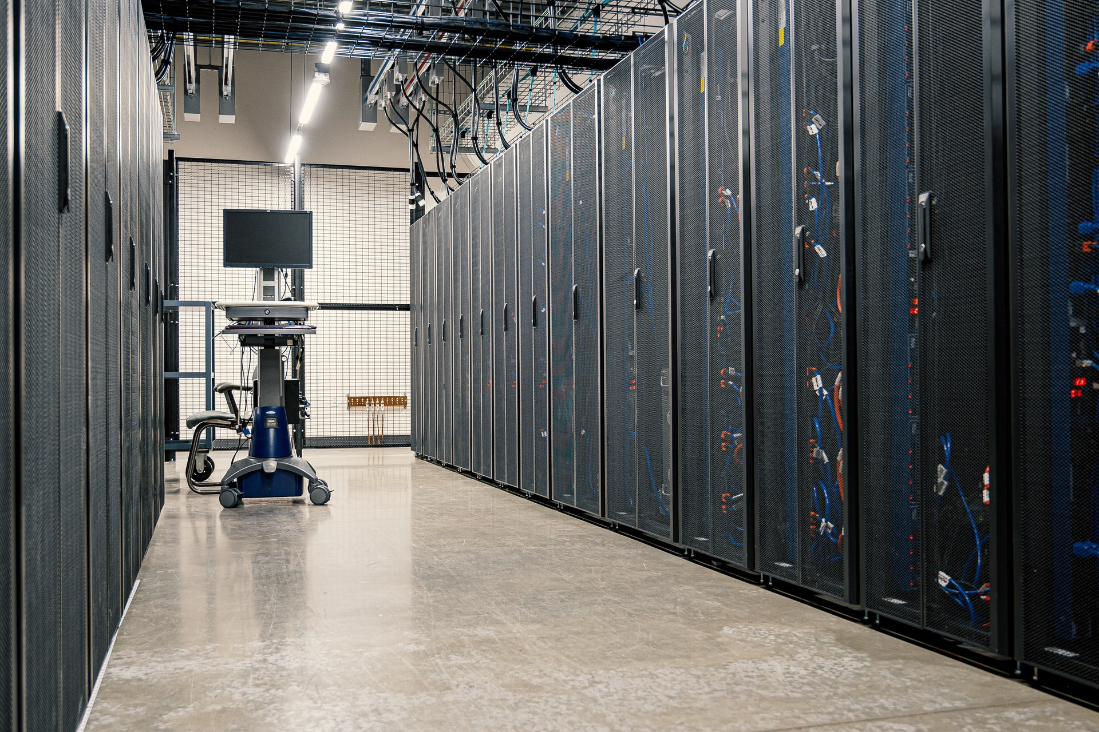
What is a modern data centre?
Photo by Brett Sales from Pexels
Notes:
Starting in the late 1980s an explosion of general purpose computers has enabled digital transformation of businesses. Dedicated mainframe computer facilities evolved and extended their footprint to accommodate racks of general purpose server hardware. New data centres have continued to evolve and optimise efficiency. Due to the enormous cost of building and refurbishing data centres there is a continuum of capability and efficiency.
Data centres are energy-hungry buildings: a small one may draw 10 Megawatts, but large can draw up to 100 Megawatts.

Slide 9
Computer Room Air Conditioning (CRAC)
Notes:
The operation of server CPU, GPU, disk and PSU all generate heat proportional to the amount of power they draw. Cooling servers can consume vast amounts of energy. Data centre computer halls use air conditioning systems to cool the room. A common computer room design is to control airflow and cooling using a concept of hot and cold aisle cooling. Managing cooling efficiently is complex, to compensate many traditional data centres are overcooled.
Typically in computer halls with passive air cooled racks typically enable a maximum power draw of 15kW. Server and server components are constantly evolving allowing more performance within a smaller footprint. With this server evolution per rack density and demand for power draw and cooling is increasing.

Slide 10
Liquid Cooled Racks
Notes:
Water has between 50 and 1,000 times the capacity to remove heat. Targeted liquid cooling enables greater server density and significantly reduces in the amount of energy required for cooling. The use of liquid cooled racks increases rack the maximum power draw capability from 15kW to 45kW.

Slide 11
Data Centres Nature For Cooling
Notes:
As computer networking technology has improved this has allowed innovation in data centre location. Hosting servers in a cold country with supplies of sustainable energy such as Iceland. Microsoft has also been experimenting in underwater data centres to reduce burden of cooling.

Slide 12
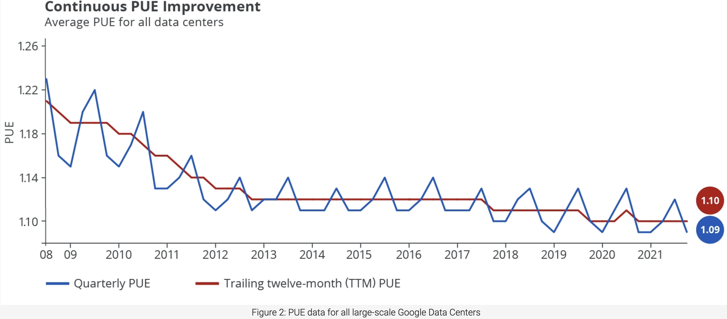
Power Usage Effectiveness (PUE)
Data center
Power system
Uninterruptible Power Supplies
Power Distribution Units
Battery backup system
IT systems
Network Switches
Network Routers
Firewalls
Servers
Storage Systems
Telco and carrier equipment
PUE =
Total data centre power demand from grid
Total power demand from IT systems
DCiE = (1/PUE) x 100
Heating, ventilation and air conditioning system
Computer Room Air Conditioning (CRAC) systems
Chiller
Data Center Infrastructure Management (DCIM) systems
https://www.google.com/about/datacenters/efficiency/
Notes:
As we’ve found there are many factors which effect the energy efficiency of a data centre. Power Usage Effectiveness was introduced in 2007 as a standardised way of measuring and compare date centre power efficiency. It is a calculation of efficiency based on the overhead of cooling and the power systems. DCiE, Data Center Infrastructure Efficiency is another term commonly seen this is just expression of PUE as a percentage.
Uptime Institute's annual Global Data Center Survey is the most comprehensive and longest running of its kind. The 2021 uptime institute report shows PUE average across all data centres as 1.57. Data centre energy costs are such a large factor for public cloud providers it is in their interests to focus on minimising this. Google have a realtime public dashboard showing their data centre PUE, presently this is running 1.09-1.10.

Slide 13
Key take away 1
Green house gas emissions can be reduced by migrating existing workloads to hosting facilities with lower PUE.

Slide 14
Grid carbon intensity - gCO2eq/kWh
https://www.nationalgrideso.com/news/introducing-our-carbon-intensity-app
Notes:
The carbon intensity of electricity is the number of grams of carbon dioxide (CO2) it takes to make one unit of electricity at one kilowatt per hour (kW/hour). Electricity that’s generated using fossil fuels is more carbon intensive, as the process by which it’s generated creates CO2 emissions. Renewable energy sources, such as wind, hydro or solar power, produce next to no CO2 emissions, so their carbon intensity value is much lower and often zero.
Most countries are looking to decarbonise their electricity grids. Progress towards these goals varies greatly between countries and regions within countries. The energy grid the data centre draws power from has a large impact on green house gas emissions of the hosted workload.

Slide 15
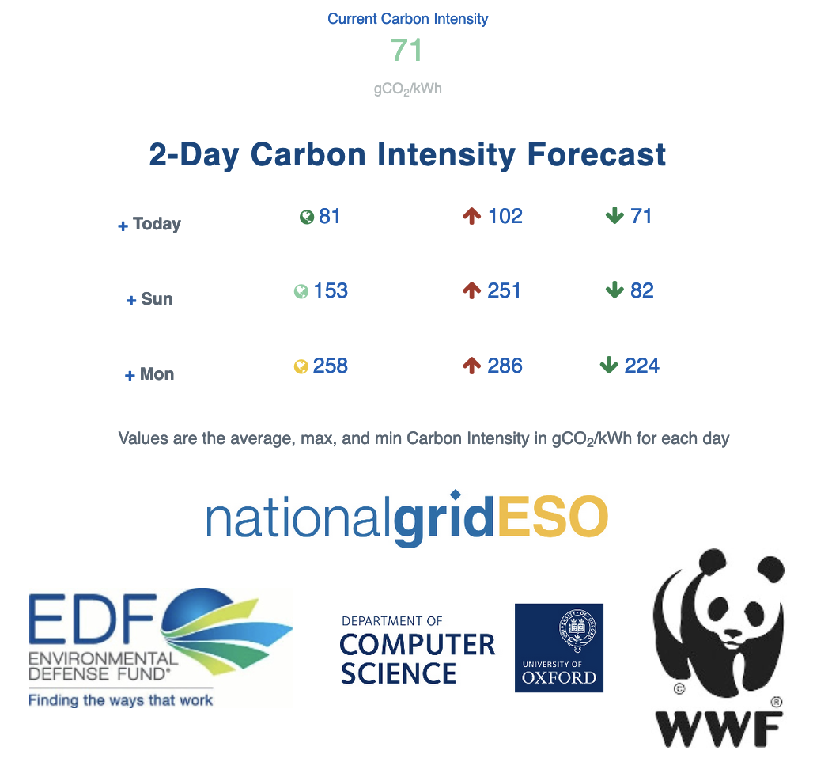
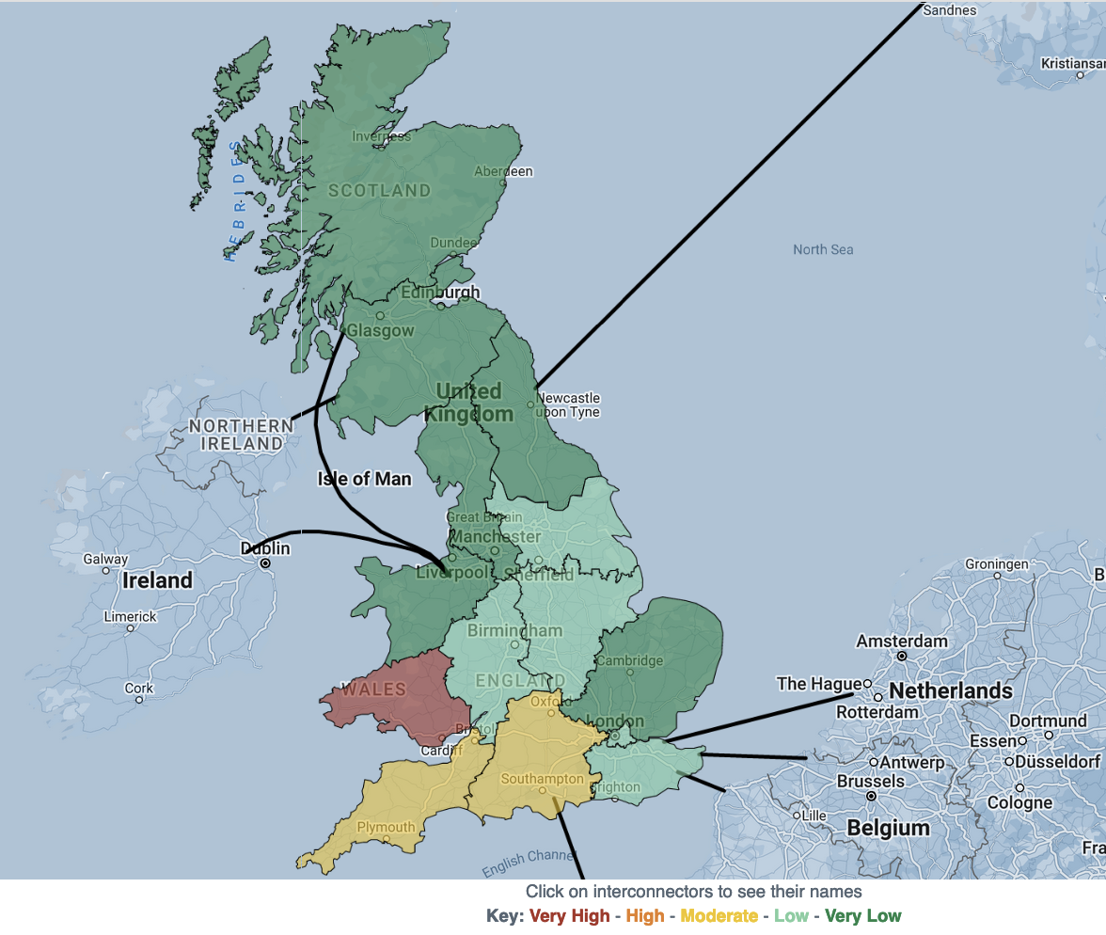
Grid carbon intensity forecasting
https://carbonintensity.org.uk/
Notes:
Renewables produce variable amounts of energy so grid carbon intensity values are dynamic. Machine learning can be used by grid operators used to produce carbon intensity forecasts.
National Grid, in partnership with with the Environment Defence Fund, University of Oxford Department of Computer Science and the WWF, have developed the worlds first Carbon Intensity forecast with a regional breakdown.

Slide 16
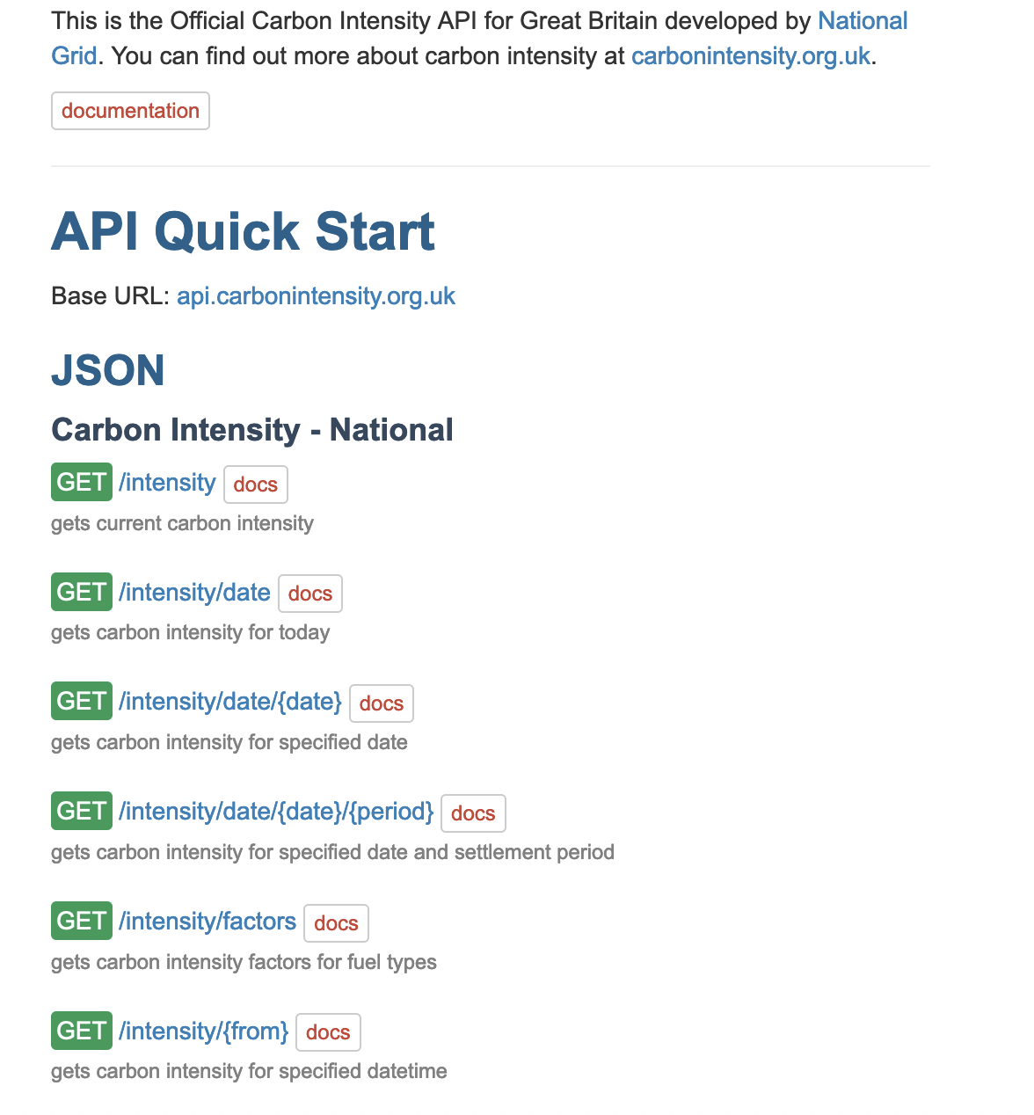
National Grid carbon intensity API
https://api.carbonintensity.org.uk/
Notes:
National Grid make the carbon intensity and carbon intensity data available accessible via their website, programatically via a public API.

Slide 17
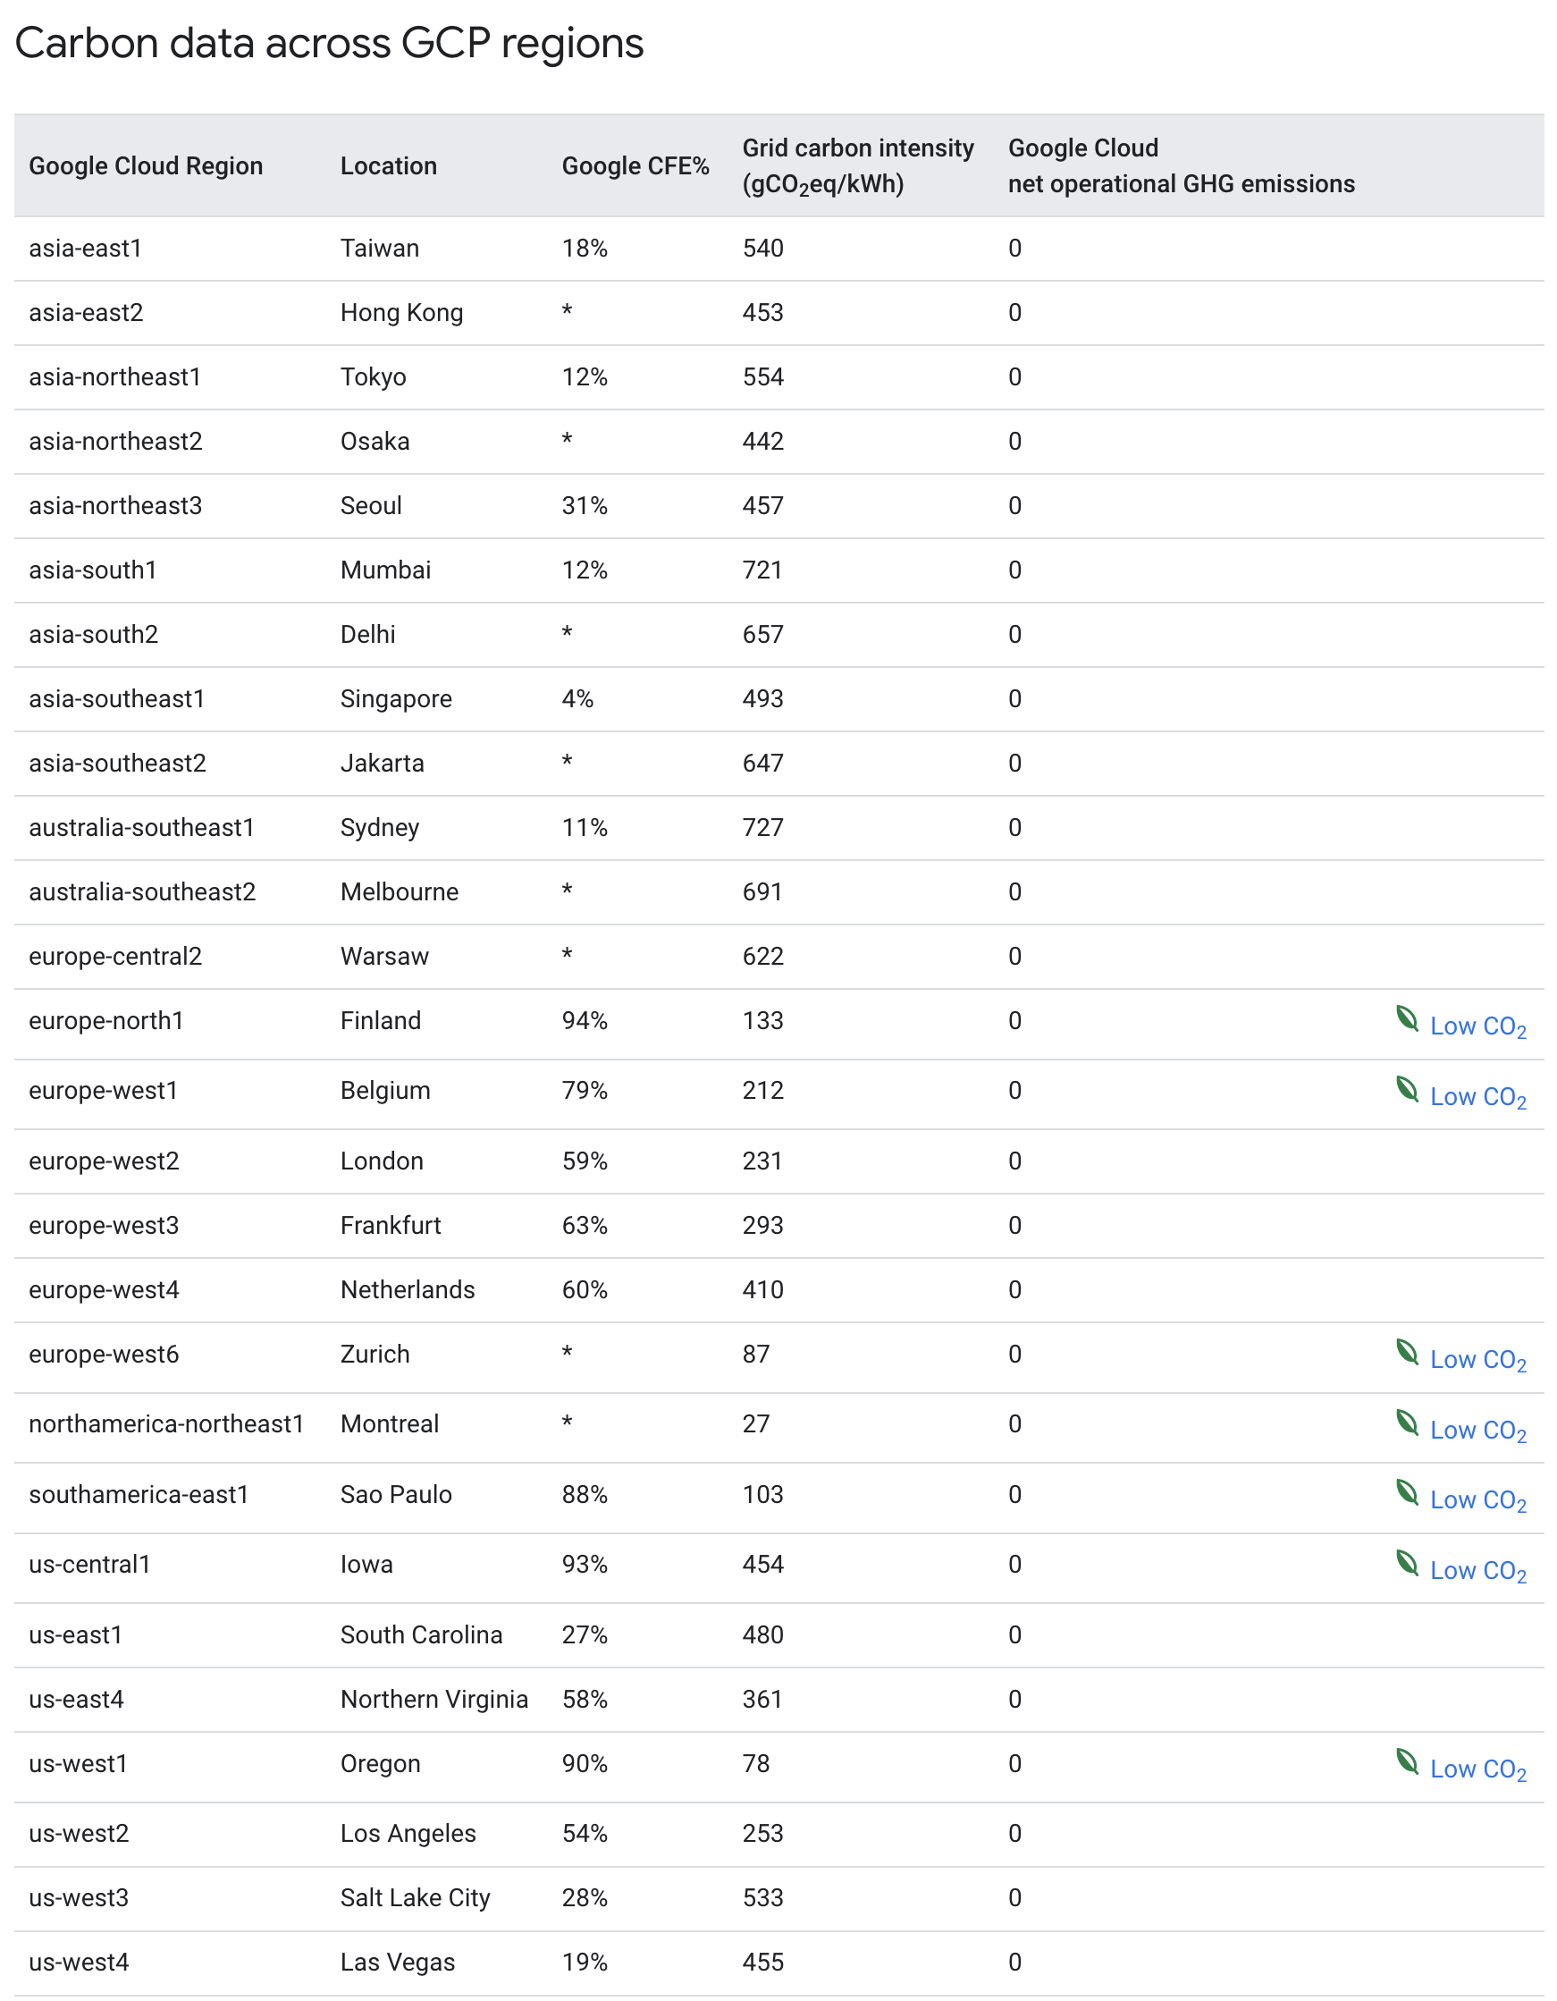
Cloud Regional Carbon Free Energy
https://cloud.google.com/sustainability/region-carbon
https://console.cloud.google.com/marketplace/product/bigquery-public-datasets/regional-cfe
Notes:
Public clouds have data centres in multiple regions each draws electricity from the grid where the region is located. As we have said the regional grids can generates more or less carbon emissions (gCO2eq), depending on the type of power plants generating electricity for that grid and when it is being consumed.
In 2020, Google set a goal to match their energy consumption with carbon-free energy (CFE), every hour and in every region by 2030. To characterize each region they use a metric: "CFE%". This metric is calculated for every hour in every region and tells us what percentage of the energy we consumed during an hour that is carbon-free. Google Cloud makes this data publicly available as a BigQuery data set.

Slide 18
Computing’s Unique Advantage
Significant spacial, temporal, and performance flexibility
Software-based fault-tolerance, eg checkpointing, replication, recompilation, etc.
Global footprint encompassing thousands of clouds and edge sites
Computing well-positioned to adapt to unreliable clean energy
Notes:
The computer software industry has a unique advantage over many other industries. Software engineering can offer significant scope around spacial, temporal and performance characteristics which can allow for flexibility in scheduling. Software can be engineered to be fault-tolerant and accommodate failure domains entire energy grids. The options for modern software workload hosting can also now be globally distributed across multiple clouds, content delivery network points of presence and edge locations. Publicly available datasets can be leveraged to make intelligent choices around carbon emissions.
The use of the carbon intensity API makes it possible to develop software with an awareness of carbon intensity which opens all sorts of design opportunities such as intelligent scheduling of workload at periods of low carbon intensity.
The Google cloud BigData data set makes it possible to programmatically schedule workload across regions with an awareness of Googles carbon free energy matching.

Slide 19
Key take away 2
Grid carbon intensity forecasting and carbon free energy matching can be used to schedule workload to run at times during windows with the lowest carbon impact.

Slide 20
CarbonFirst
http://carbonfirst.org/
Notes:
Professors and post doctoral researchers at Masschusetts Amherst and California Institute of Technology are working on a project called CarbonFirst. The project’s foundation focuses on developing a software-defined energy virtualization layer that provides applications visibility into, and control of, their own energy and carbon usage. The project is supported by the
National Science Foundation and VMware.

Slide 21
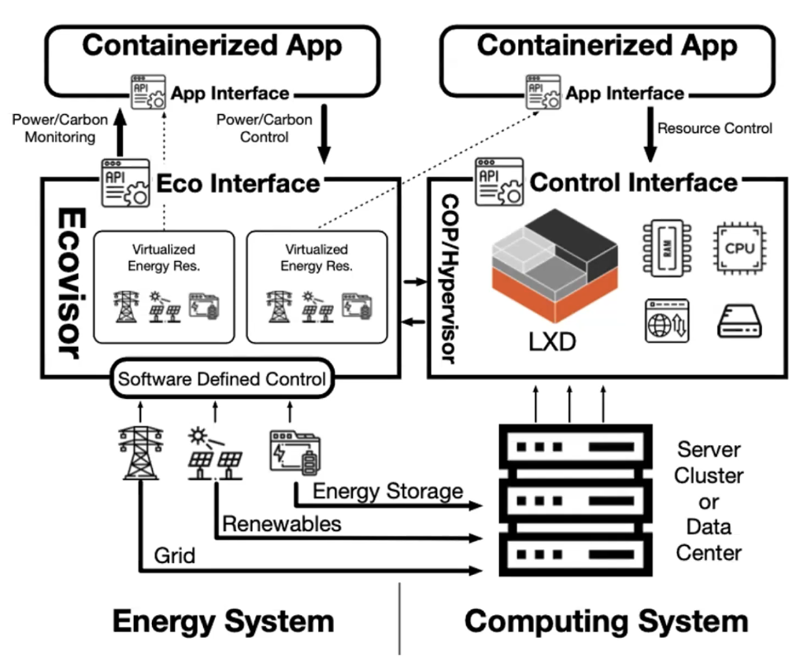
Ecovisor
Notes:
The goal is to provide a software-defined control of a virtual energy system which provides an intelligent abstraction. It is akin to a hypervisor but virtualises the energy system instead of server hardware. It takes feed from energy system metrics and exposes these via an API to the virtual clusters. This would allow enablement of workload policies to determine the applications share of grid power, solar and battery capacity.

Slide 22
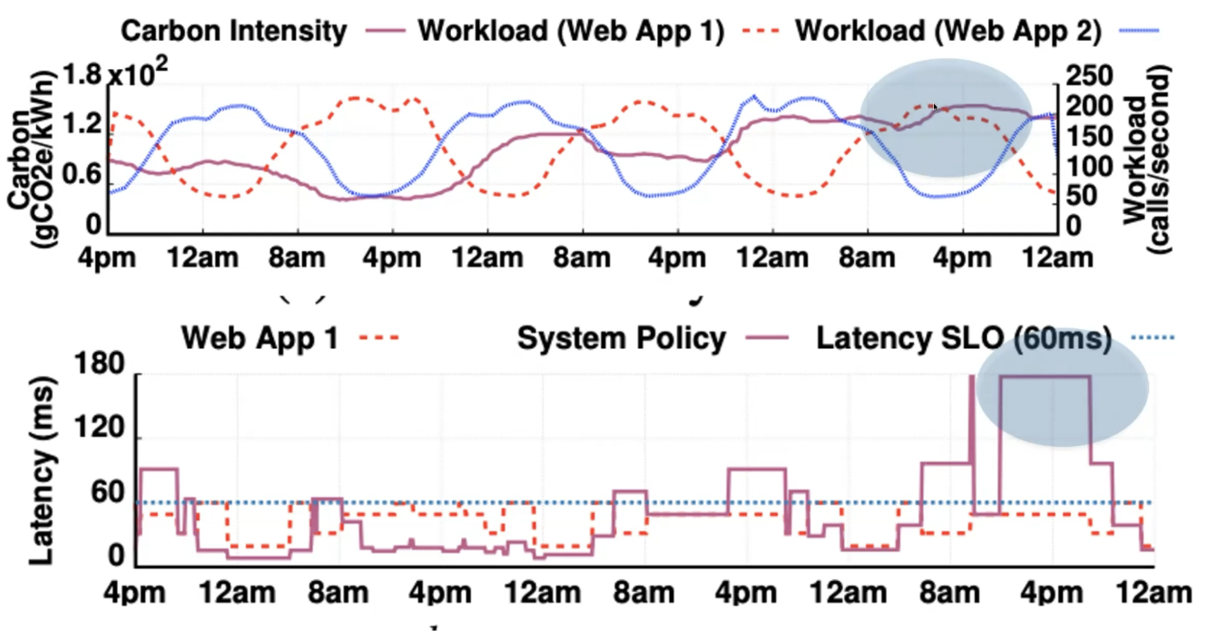
Application Aware Carbon Budgeting
Notes:
A realtime feed of the energy metrics via the ecovisor would enable application specific carbon budgeting to be considered in workload scheduling as opposed to system level carbon-rate limiting. Allowing the application to be engineered to be aware and work within a carbon budget offers potentially much more predictable application performance.

Slide 23
Key take away 3
Make forward looking software engineering designs which can accommodate upcoming carbon awareness innovations.

Slide 24
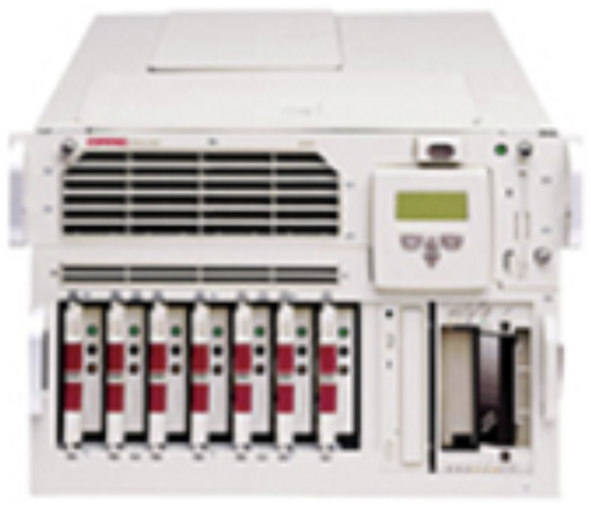
Midrange Server Evolution
1980s floor mount tower systems
like the NCR 3000 Series
1998 Compaq Proliant 6500
Max five 7U server housed within 42U rack
2GHz (4x 500MHz) CPU per server
4GB RAM per server
500watt power draw per server
10GHz CPU per rack
20GB RAM per rack
2.5kW power draw per rack
4GHz CPU per 1kW
2006 HPE C7000 with BL460c G1
Four 10U chassis housed within 42U rack
Sixty four servers housed within 42U rack
13.3GHz (quad-core 3.33GHz) CPU per server
48GB RAM per server
7,200watt power draw per chassis
852GHz CPU per rack
3TB RAM per rack
28.8kW max power draw per rack
29.6GHz CPU per 1kW
2022 HPE C7000 with BL480G10 Pus
Four 10U chassis housed within 42U rack
Forty eight servers housed within 42U rack
124GHz (forty-core 3.1GHz) CPU per server
4TB RAM per server
7,200watt power draw per chassis
5,960GHz CPU per rack
192TB RAM per rack
28.8kW max power draw per rack
207GHz CPU per 1kW
Notes:
Through the 1980s and 90s computer usage within all businesses grew massively. Initially these general purpose computers had tower form-factor and were placed on the floor of the old mainframe computer rooms. With structured data centre facilities came standardised rack hosting of servers. Server hardware has evolved continually since with each generation of hardware bringing improved CPU performance and power efficiency.
Enterprise grade server components have also evolved to have incredibly low meantime between failures with longer serviceable lifetimes.

Slide 25
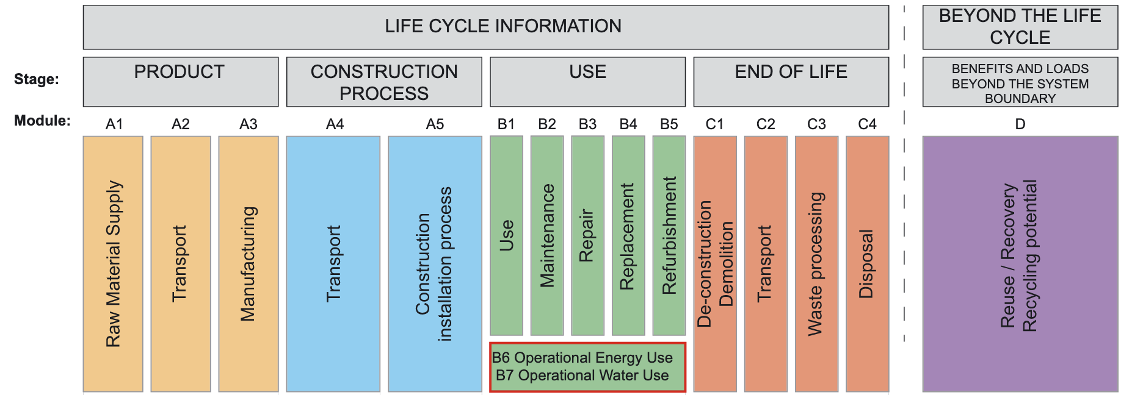
Operational carbon Vs Embodied carbon
https://www.istructe.org/IStructE/media/Public/TSE-Archive/2020/A-brief-guide-to-calculating-embodied-carbon.pdf
Notes:
Servers are typically build from metals and silicon. The embodied carbon impact of infrastructure lifecycle also needs to be considered.

Slide 26
Waste Electrical and Electronic Equipment
https://globalewaste.org/
Notes:
The global e-waste statistics partnership is a programme under the united nations who’s goal Is to:
Collect and improve worldwide e-waste statistics
Enhance the understanding and interpretation of global e-waste data
Improve the quality of e-waste statistics by guiding countries and building national capacity through e-waste statistics trainings
Raise awareness and communicates the data to the general public and relevant stakeholders

Slide 27
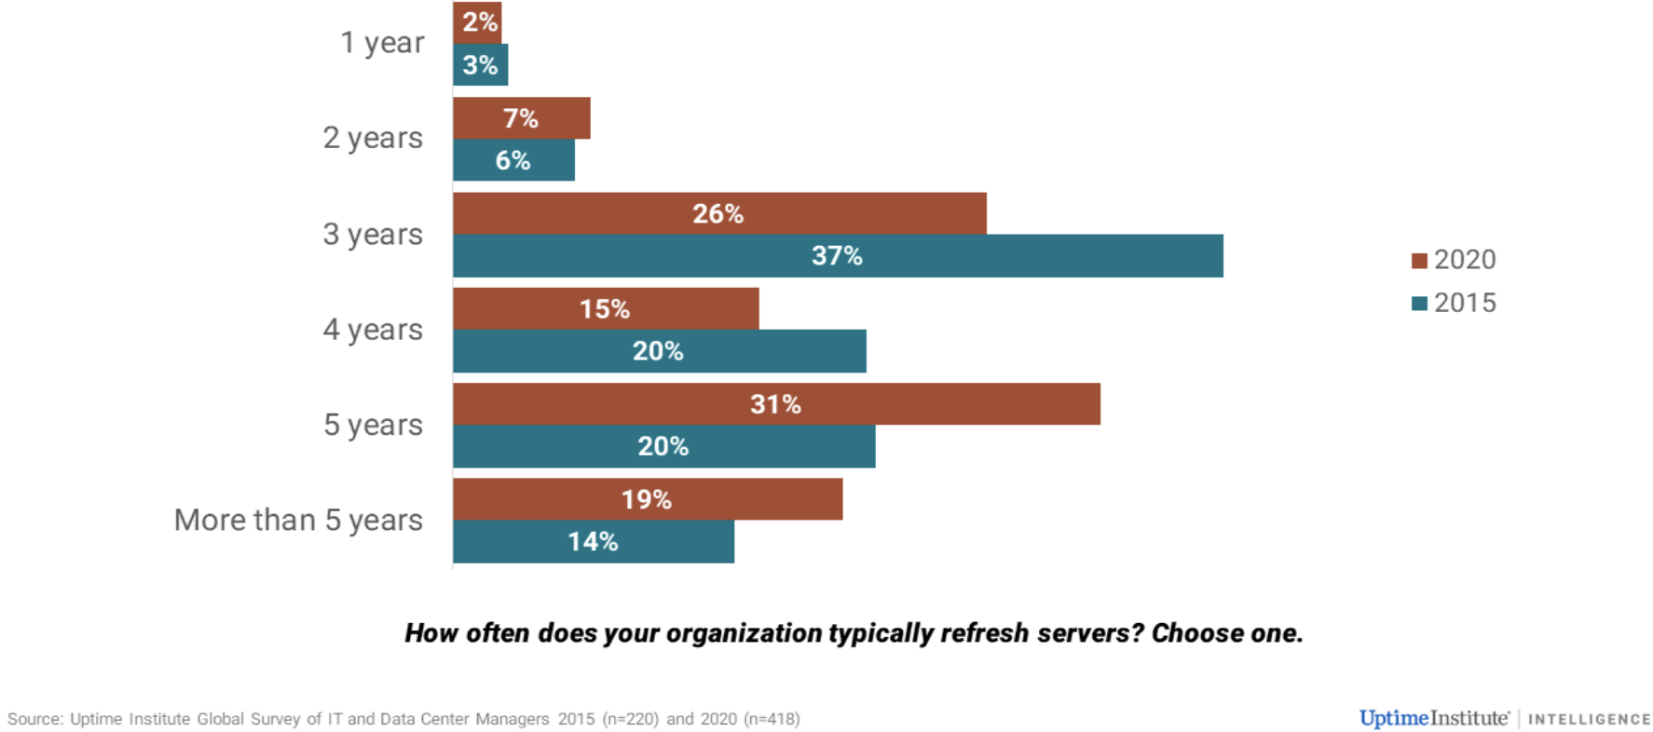
Optimised Hardware Refresh Cycles
Notes:
With CPU core speed remaining flat, improvements in IT require more multi-core processors and, consequently, more power consumption per operation. The the case for frequent hardware refreshes to improve performance has diminished. The most common period for a hardware refresh in 2015 was three years; in 2020, it had extended to five years. Increase hardware refresh cycle interval directly decreases embodied carbon impact.

Slide 28
Key take away 4
Technological advances enables more processing capabilities at same or lower power requirements. Increasing server hardware technology refresh cycles are a great opportunity to increase embodied carbon efficiency.

Slide 29
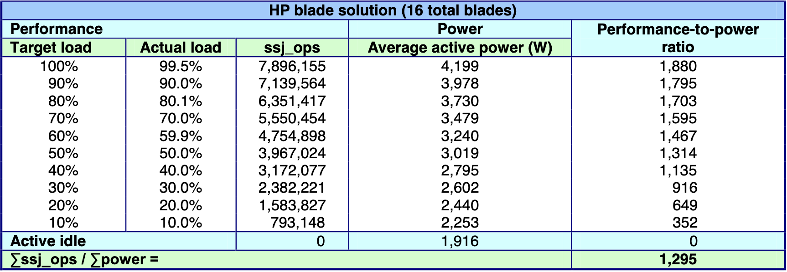
Performance to Power Ratio
Lower active power (W) results are better. Higher ssj_ops and performance-to-power ratios are better.
https://i.dell.com/sites/doccontent/business/solutions/whitepapers/en/Documents/poweredge-m610-power-competitive-whitpaper.pdf
Notes:
Many server components constantly draw power, disk, network, memory, fans, the effect is with no active workloads the chassis draws ~2,000watts. When the server chassis is powered on with no workload, in Active Idle state it is consuming 2kW. The CPU has a variable power draw, each 10% workload increment draws additional ~200watts. Highly loaded servers are more power efficient.

Slide 30
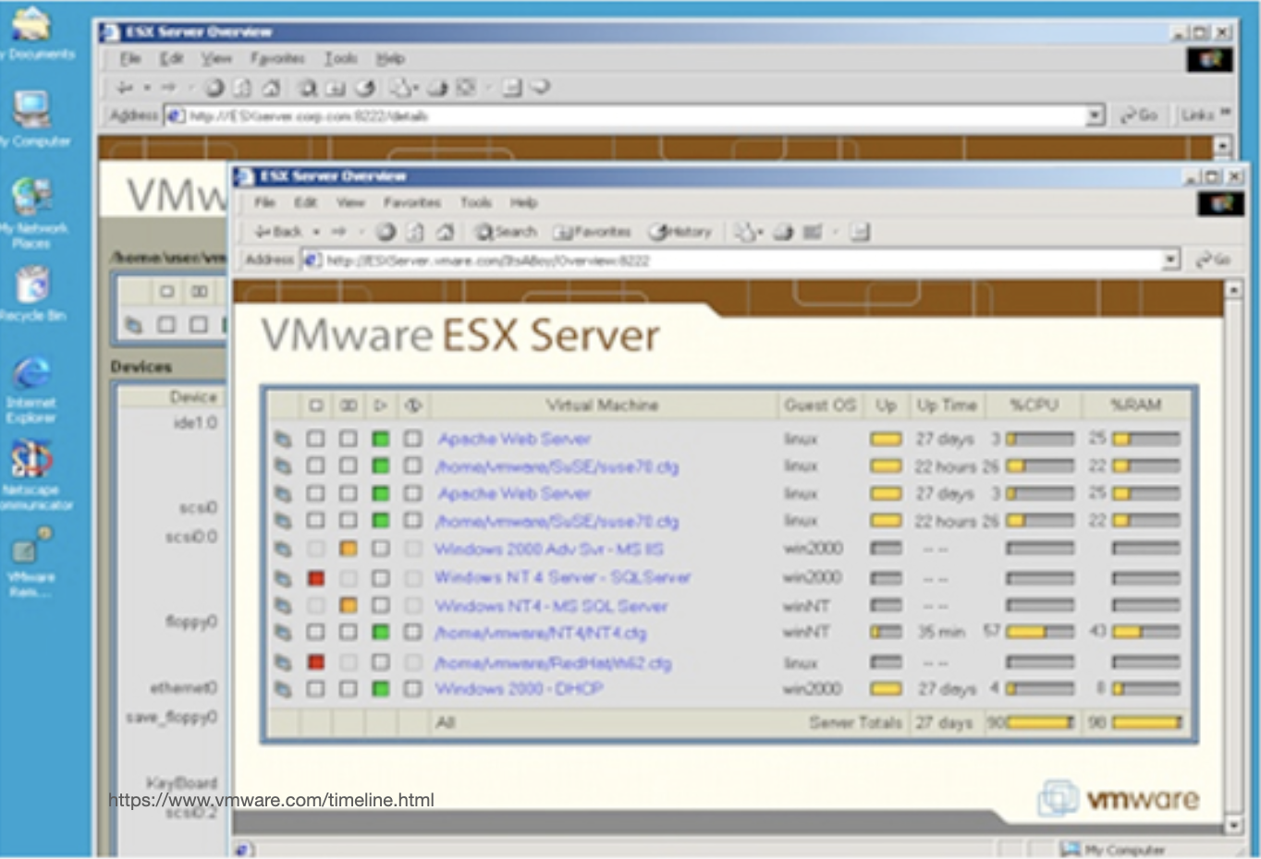
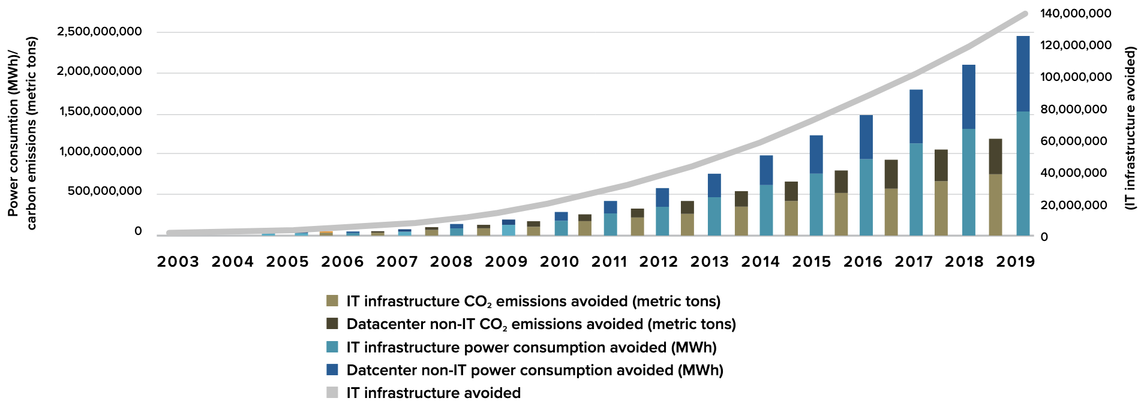
Increasing Workload Density With Hardware Disaggregation
https://www.vmware.com/content/dam/digitalmarketing/vmware/en/pdf/company/vmware-idc-whitepaper-2020.pdf
https://www.vmware.com/timeline.html
Notes:
Virtualization of workload increases density which increases power efficiency. Since early 2000’s VMware ESX has enabled the consolidation of multiple servers onto fewer physical devices.

Slide 31
Key take away 5
Server virtualisation is an easy way to increase workload density which increases energy efficiency without refactoring application architecture.

Slide 32
Workload Demand Optimisation
CPU
RAM
Storage
Oversized virtual machines
Orphaned\ idle virtual machines
Over provisioned cluster capacity
Standby disaster recovery capacity
Oversized virtual machines
Orphaned\ idle virtual machines
Over provisioned cluster capacity
Standby disaster recovery capacity
Oversized virtual machines
Orphaned\ idle virtual machines
Over provisioned storage capacity
Standby disaster recovery capacity
Virtual machine snapshots
Notes:
However with the advent of server virtualisation came the dawn of workload sprawl. With the ease of provisioning it is easy for large estates become inefficient. Implement continuous monitoring and continuous improvement day two operations programs. Modern virtual machine monitoring tooling typically has capabilities to continuous monitoring and report on workload inefficiency. Workload efficiency remediation under change control can manually remediated or be performed using Robotic Process Automation.

Slide 33
Key take away 6
Implement continuous monitoring and continuous improvement day two operations programs to identify and eliminate waste.

Slide 34
Workload availability optimisation
Two node cluster 50% unused overhead
Five node cluster 20% unused overhead
Five node cluster 10% unused overhead
Notes:
Typically clusters are designed to provide high ability with resources to restart workload in event of host failure. A common security design pattern was to have network security zones with boundary aligned to the cluster boundary. The design pattern of network placement aligned to cluster placement led to a high number of small server clusters. Small clusters designed for workload availability have a higher percentage of resources unused. Having a high number of small clusters further increases unused resources.
The adoption of software defined networking and micro-segmentation offers a simple solution for decoupling of network and cluster placement. This allows for larger more efficient clusters.

Slide 35
Key take away 7
Refactoring network architecture towards SDN and enable larger clusters.

Slide 36
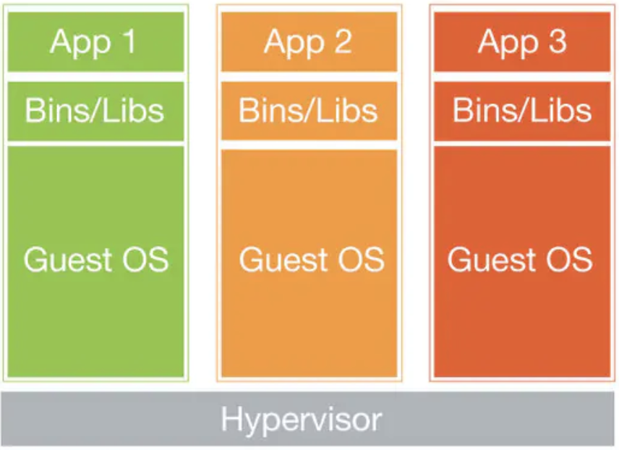
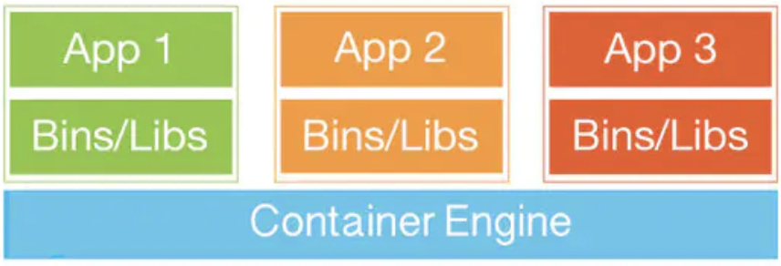
Shared kernel architectures
Virtual Machine
Containers
Notes:
To behave consistently applications require isolation from other applications. With virtual servers isolation is achieved by each running an OS and single application service instance. With containers a single guest kernel can service multiple isolated application service instance. Ease of isolation of parts of a system allows applications to be more atomic micro-services. Sharing OS kernel reduces resource requirement for each application.

Slide 37
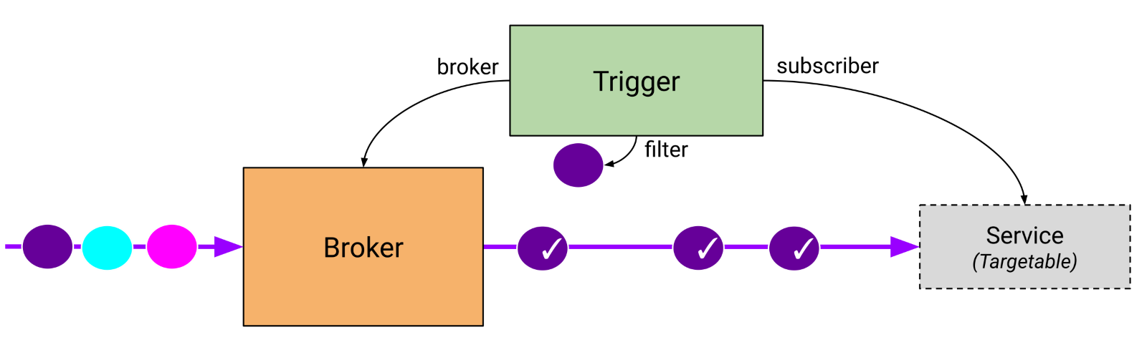
Event driven scale to zero architectures
Knative
Notes:
Kubernetes is designed to keep multiple copies of containers running and can react to auto-scale. In the scale-to-zero model, the containers are only started when required. A piece of software is inserted between inbound requests and the container.

Slide 38
Key take away 8
Refactoring application architecture towards containerised architectures can unlock per workload energy efficiency. Containerised architectures unlock the capability to harness scale to zero orchestrator solutions which further eliminate waste.

Slide 39
Complex to Reduced Instruction Set Computers
https://amperecomputing.com/blogs/2022-03-16/overwhelming-cloud-native-processor-leadership-with-ampere-altra-max.html
https://www.phoronix.com/scan.php?page=article&item=ampere-altramax-benchmarks&num=1
Notes:
AArch64 Linux has matured very well it is as easy to adopt as x86_64. Delivers better performance levels while consuming lower power. 2x improved performance per watt across various workloads.

Slide 40
Key take away 9
Refactoring application architecture from complex to reduced instruction set architectures can unlock massive per workload energy efficiency.

